Slide 1

Project Pitch
Skynet Squad

Slide 2
Topic of Interest
Enhancing the Applicant Tracking System (ATS) to provide a more comprehensive candidate evaluation, identify well-rounded early talent, and streamline the job application and recruitment process.

Slide 3
The Business Problem:
Key issues associated with AI resume screening
Why should you care?
Qualified applicants can be rejected before a human reviews their resume
Applicants can use word injection to get around ATS screening.
Applicants receive limited visibility in automated rejections
Companies can miss out on qualified applicants with current state of application screening
As students entering the future workforce, we will all interact with ATS
Improved ATS will allows for employers to find qualified candidates that may be overlooked
Investing in future workforce means better quality output
Everyone wins

Slide 4
Data Strategy
Sources: Three proposed Kaggle datasets containing resume profiles, job postings, and recruitment records.
Data needed: Resume text, skills, education, experience, and job requirements.
Preparation: Focus on one job family, check data quality, remove duplicates, and standardize fields.
Analysis: Generate keyword and AI match scores, review a small sample manually, and test name changes while keeping qualifications identical.
Storage: Organize evaluations into one fact table and four dimension tables for Power BI.
Notes:
We’ll use resume and job-description data to compare candidate qualifications with employer requirements. After cleaning the data, we’ll generate matching scores and check a small sample ourselves. We’ll also test whether changing only a name affects the results. These evaluations will feed our SQL warehouse and Power BI report.

Slide 5
Project Flow in Theory
Notes:
We’ll build a simplified ATS screening prototype and use Power BI to highlight where it overlooks relevant qualifications, disagrees with our team’s review, or changes rankings when only a name changes.

Slide 6
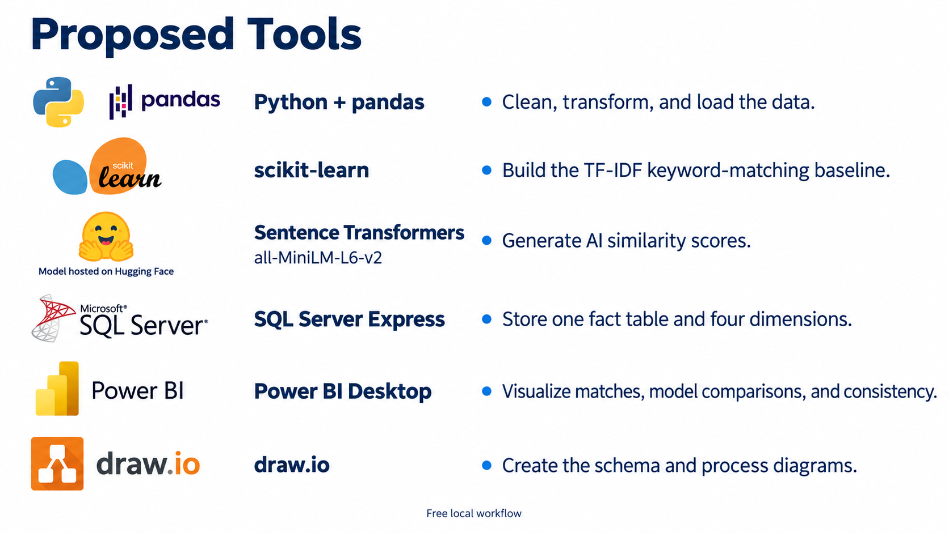
Notes:
Ai model / natural language processing model scikit to build the nlp for matching job descriptions and skills to key resume words
Example – resume – extract text – compare with job description embedding – skill/requirement checks – score- ranked candidate

Slide 7

Q & A

